Slide 1
CE 574: Stepwise Linear Regression
Sava River – Jesenice Gauge
Madi Brake

Slide 2
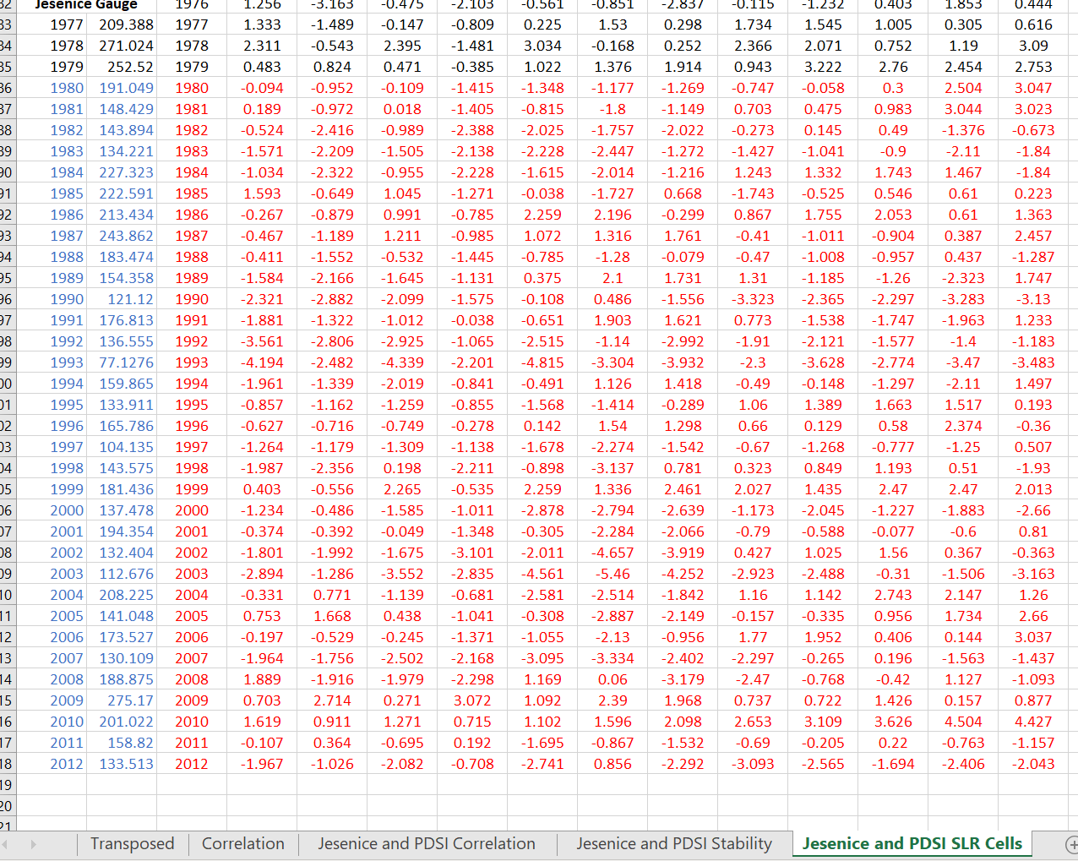
SLR Walkthrough
The "Jesenice and PDSI SLR Cells" that passed the correlation and stability prescreening were put on a separate sheet for the stepwise linear regression deliverable for Sava River reconstruction.
The independent variables for SLR are the PDSI cells that passed the prescreening.
The dependent variables for SLR are the streamflow measurements for the Jesenice Gauge over the years of interest.

Slide 3
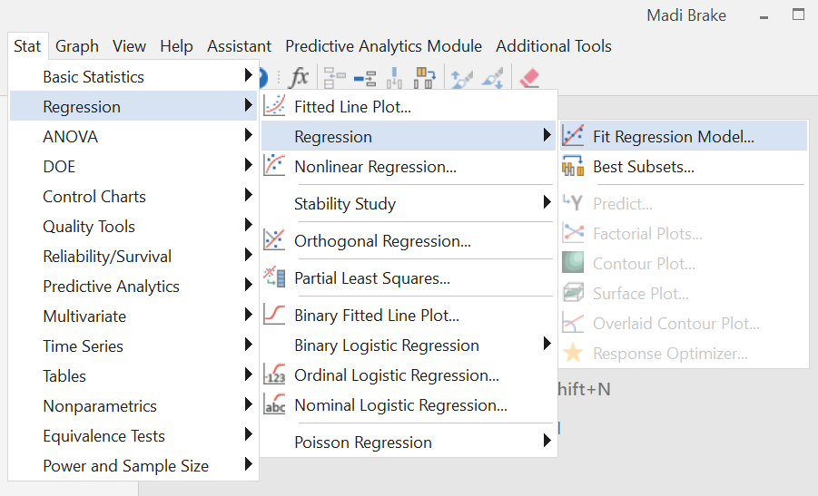
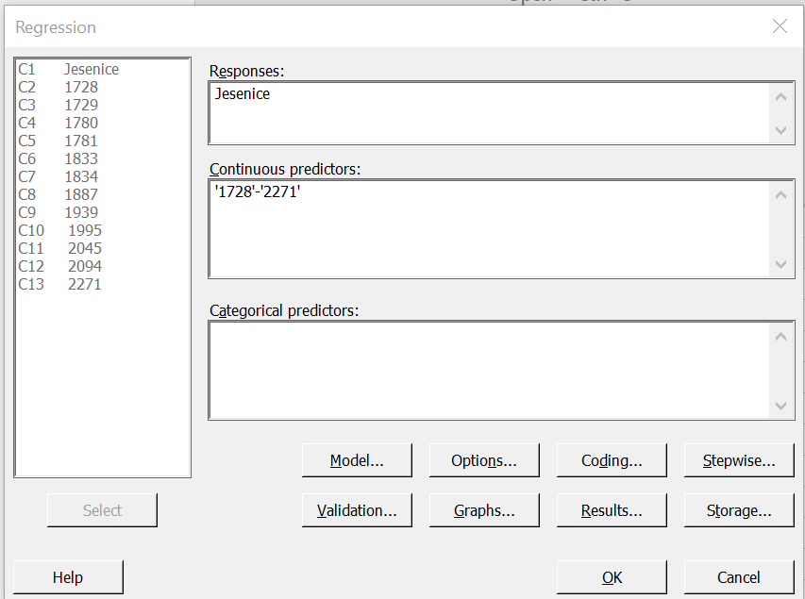
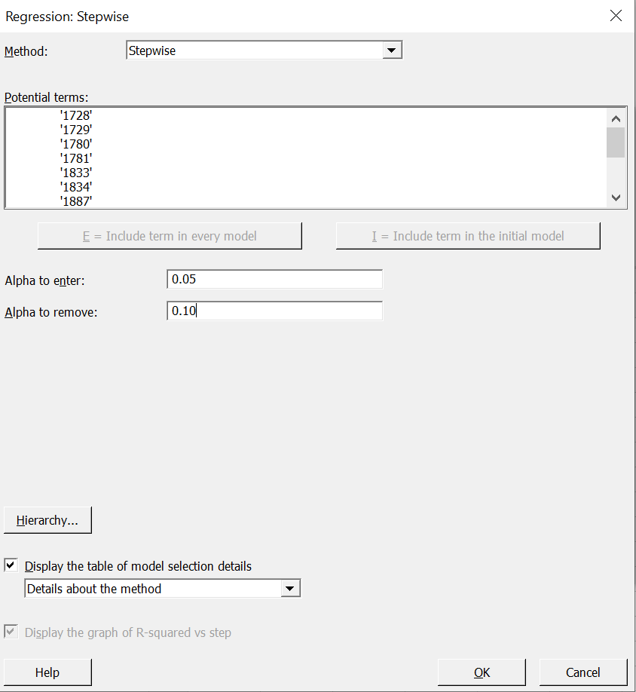
SLR Walkthrough
2) The data was inserted into the Minitab software for the years 1980 – 2012 Jesenice streamflow data and the corresponding retained PDSI data.
A fit regression model was created with the PDSI cells used as continuous predictors.
Stepwise regression was selected, and the alpha value to enter was changed to 0.05, and the alpha value to remove was changed to 0.10.
The Durbin-Watson statistic was selected to be shown on the results of the SLR.

Slide 4
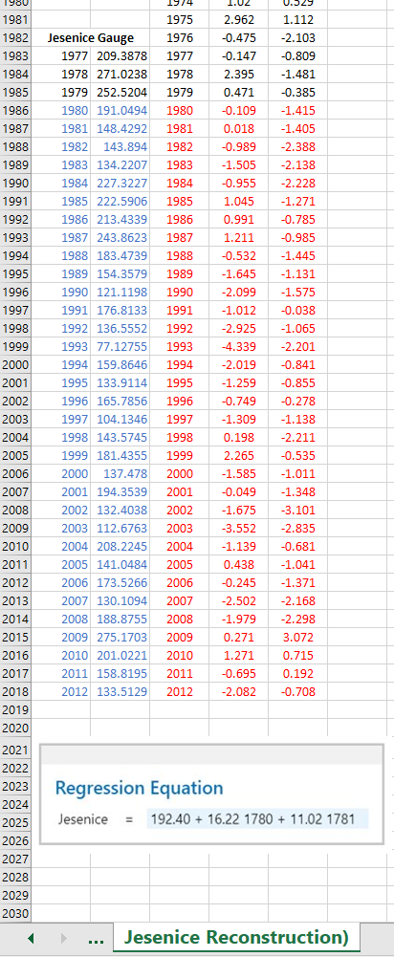
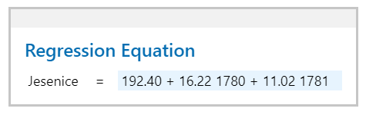
SLR Walkthrough
3) The regression equation was generated and pasted into a new excel sheet titled "Jesenice Reconstruction.".
4) PDSI cells 1780 and 1781 were retained, and the others were deleted from the reconstruction spreadsheet.

Slide 5
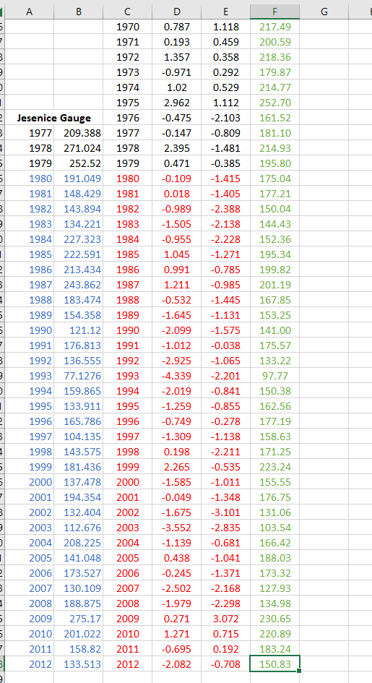
SLR Walkthrough
5) The regression equation was inserted into the spreadsheet for the year 2012 and copied all the way back to year 0 (as far as the PDSI cells go back) and were marked in green to show the reconstructed data versus observed data, marked in blue.

Slide 6
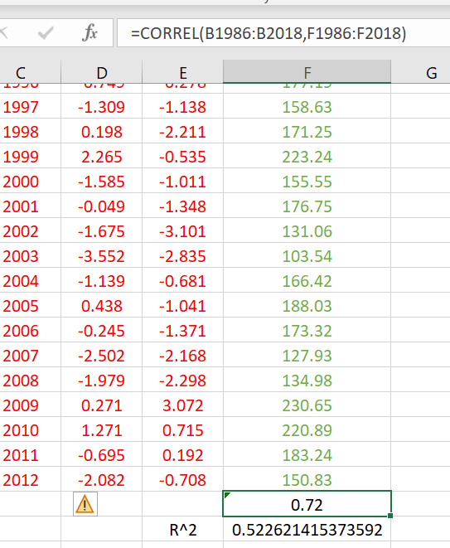
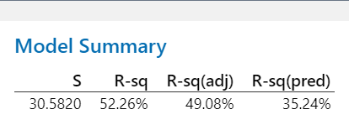
SLR Walkthrough
6) The model summary from Minitab gave an R^2 value of 52.26%
7) This was validated in Excel by calculating the R^2 value by correlating the streamflow vs PDSI data for 1980-2012 and squaring it. This yielded 52.25%.

Slide 7
SLR Walkthrough
8) The data in the Excel sheet and Minitab workbook were saved for the next deliverable: skill (fit validation) statistics.
This will be done to determine how strong the Sava River reconstruction is for the Jesenice Gauge.

